Slide 1
Comparison of Software Development Life Cycle (SDLC) Models
By: Yujan Basnet
Roll No:18

Slide 2
Introduction
SDLC stands for Software Development Life Cycle.
It is series of phases that provide a model for software development.
Different Models of SDLC are:
Waterfall
Iterative
Prototype
Spiral
Notes:
Different Models Mentioned here : waterfall, iterative, prototype model and spiral model.
Waterfall – A step-by-step, linear approach. Finish one phase before moving to the next (like a waterfall flowing down). Best for: Simple, well-defined projects.
Iterative – Build a basic version, improve it in cycles (iterations), and keep refining. Best for: Projects that need frequent updates.
Prototype – First, create a quick model (prototype) to test and get feedback, then build the final product. Best for: Projects where requirements are unclear.
Spiral – A mix of iterative and risk management. Develop in loops (spirals), refining at each stage while analyzing risks. Best for: Complex and high-risk projects.

Slide 3
Software Development Process
Software Engineering processes are composed of:
• Requirements Analysis
• Specification
• Software architecture
• Implementation
• Testing
• Documentation
• Training and Support
• Maintenance

Slide 4
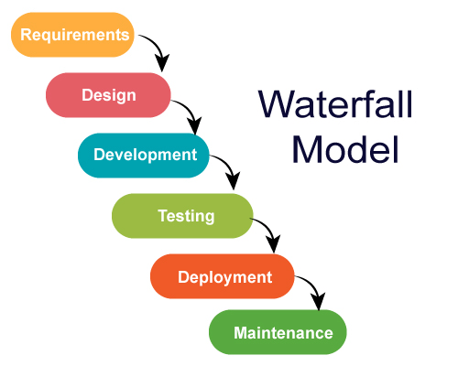
Waterfall Model
It is a sequential development model.
Advantages:
Simple and easy to use.
Phases are well defined.
Works well for small projects with clear requirements.
Disadvantages:
Hard to modify requirements once testing starts.
No working software until late stages.
High risk and uncertainty

Slide 5
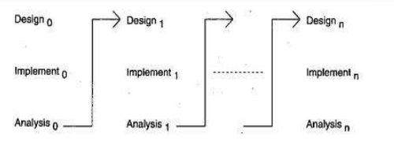
Iterative Model
Development happens in iterations(cycles) improving in each iteration.
Advantages
Allows feedback at each stage.
Works well with projects with evolving requirements
Disadvantages
Costly System Architecture.
No clear milestones in development process.
Each phase of iteration is rigid with no overlaps.

Slide 6
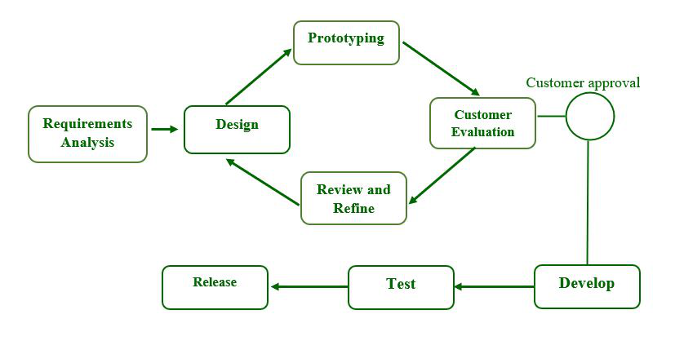
Prototyping Model
Building of Prototype occurs according to the current requirements and after the user’s approval final development starts.
Advantages:
Users get an early look at the system.
Errors and misunderstandings are identified early.
Disadvantages:
May lead to unfinished or rushed systems.
High development costs.
Notes:
Actual feel of the system

Slide 7
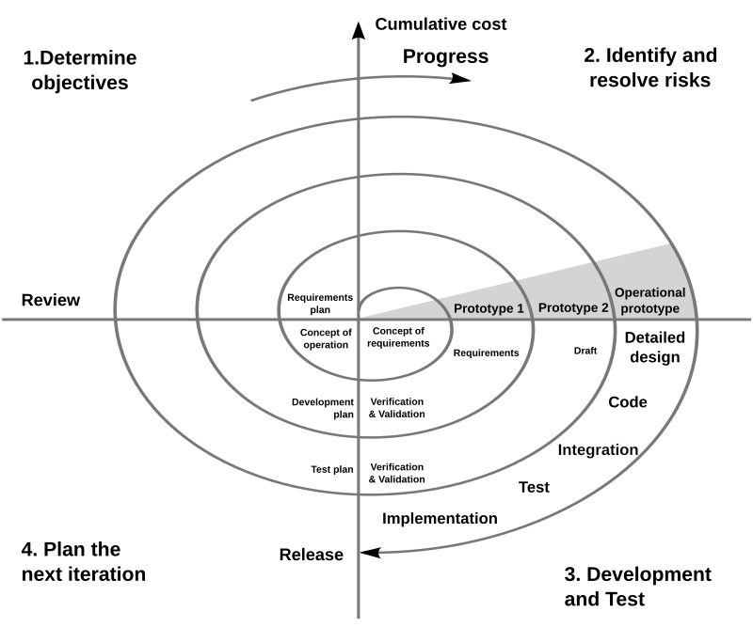
Spiral Model
Combines iterative and waterfall model and is risk driven.
Advantages:
Good for large, complex projects.
Strong risk assessment and management.
Disadvantages:
Expensive to implement.
Requires expertise in risk management.

Slide 8
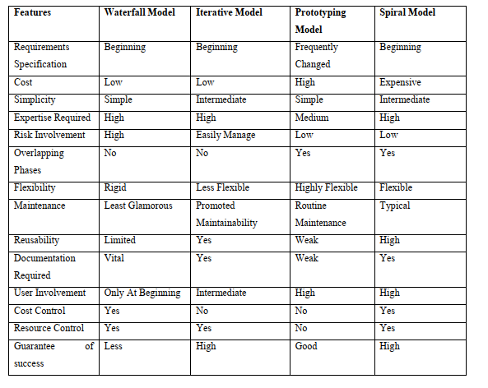
Comparision

Slide 9
Conclusion
There are many existing SDLC models for developing systems with different requirements.
Waterfall model is used by various big companies for their internal projects.
Most commonly used models for developing systems are waterfall model and spiral model.
Each model has advantages and disadvantages for developing the systems, so each new model tries to eliminate the disadvantages of previous model

Slide 10
References
Gupta, Ashish Kumar. "A Comparison Between Different Types of Software Development Life Cycle Models in Software Engineering." International Journal of Advanced Technology in Engineering and Science, Vol. 3, Issue 3, March 2015.

